Slide 1


AI-POWERED DAMAGE DETECTION, REMEDY MEASURES & SERVICE PROVIDER RECOMMENDATION
Ms. Nimmy Francis
Assistant Professor
Mathew Peter
INMCA 2020-2025

Slide 2
CONTENTS
Abstract
Literature Survey
Introduction
Methodology
Results and Discussion
Conclusion
References

Slide 3
ABSTRACT
Streamlines the identification and diagnosis of motor, plumbing, and electrical device issues.
Advanced machine learning to accurately detect faults and anomalies.
Enables users to upload images of faulty or damaged components for automated analysis.
Processes images through a trained Convolutional Neural Network (CNN) model for precise issue detection.
Delivers AI-powered repair recommendations and connects users with top-rated service providers for complex problems.

Slide 4
LITERATURE SURVEY
AI for Home Maintenance: Used deep learning for fault detection but lacked service provider integration. AI Home Repair Study [1]
Automated Appliance Diagnostics: Combined image processing and IoT but required specialized hardware. Smart Home Diagnostics Research [2]
AI Service Matching: Matched users with providers using machine learning but lacked real-time feedback. Service Matching Study [3]
Speech Recognition in Home Services: NLP-based chatbots for booking, affected by accents and noise. Google AI Research [4]

Slide 5
INTRODUCTION
Automated Issue Identification: Uses machine learning to scan and analyze images of faulty motor, plumbing, and electrical components.
Quick Problem Detection: Instantly determines the issue when a user submits a picture of a damaged part.
Repair Recommendations: Suggests potential solutions to fix the problem.
Service Provider Suggestions: If the issue cannot be easily resolved, the system recommends top-rated service providers.
Guaranteed Repairs: Ensures users receive accurate and effective repair solutions.

Slide 6
METHODOLOGY
1. Image Dataset Collection
Collected images of home maintenance issues from real-world scenarios and online sources. Categorized and labeled data to build a structured dataset for fault detection and service optimization.
2. Preprocessing and Data Preparation
Resize images to a standard size for the model. Split the dataset into 80% for training and 20% for testing/validation.
3. Model Development
Developed a CNN model to classify home maintenance issues using a structured image dataset. It efficiently detects faults and recommends services.

Slide 7
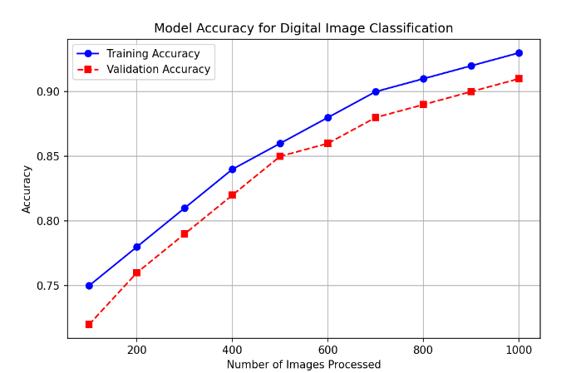
METHODOLOGY
4. Training Process
Train the model using an optimization method to help it learn patterns in the data. The model improves by reducing errors (loss) over multiple training rounds and becomes better at identifying diseases.
5. Evaluation and Validation
Test the model with new images (validation set) to check accuracy. Compare the model's predictions to the correct labels.

Slide 8
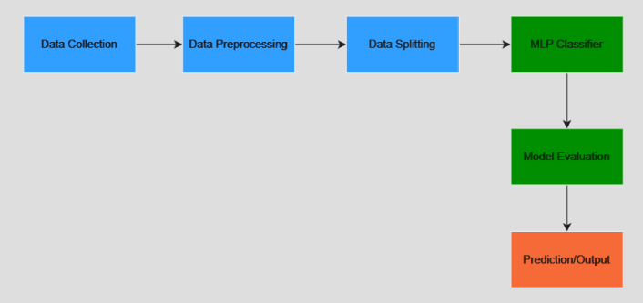
METHODOLOGY
6. Issue Detection and Service Provider Recommendation
After an image is uploaded, the system analyzes it to identify the issue. It then displays the fault type, confidence level, a brief description, suggests possible solutions, and recommends suitable service providers.

Slide 9
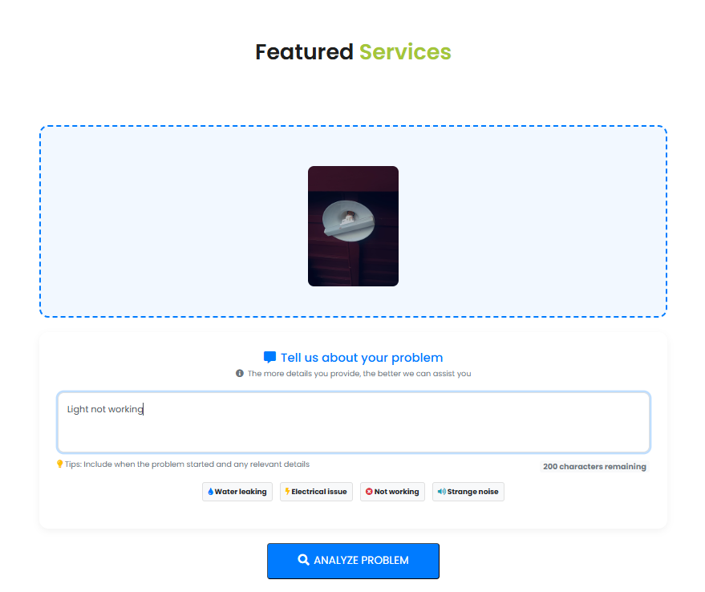
RESULTS AND DISCUSSION
UI of service prediction

Slide 10

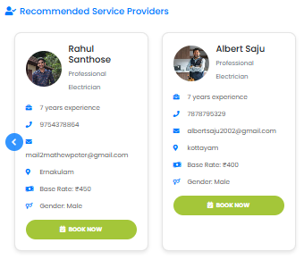
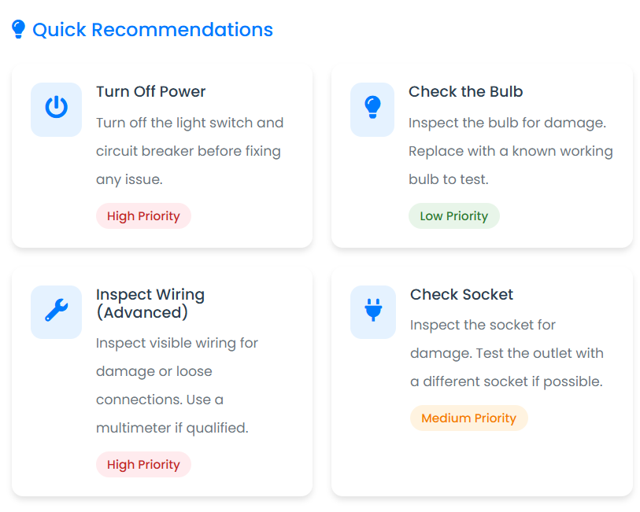
RESULTS AND DISCUSSION
Output of available service solutions
Output of service Provider Recommendation

Slide 11
CONCLUSION
The AI-powered image recognition system quickly detects faulty home components using advanced machine learning algorithms.
Users can upload images of damaged parts, and the system automatically analyzes and provides accurate repair recommendations.
If a repair cannot be done independently, the system connects users with top-rated service providers for professional assistance.
The automated diagnostics streamline the repair process, reducing overall repair time and minimizing unnecessary costs.

Slide 12
REFERENCES
[1] Kong Dali, Cui Yang. Researches Status and Develop Direction of Digital Image Processing Technology.
[2] Various Authors, "Applications of AI in Home Maintenance Services," Journal of Emerging Computer Applications, 2023.
[3] Google AI Team, "Speech Recognition and Chatbot Integration," Research Paper, 2022.
[4] Industry Reports, "Digital Transformation in Home Services," 2021.

Slide 13
THANK YOU

